Slide 1

Customer Churn Analysis in Banking Sector
By- Aravind Kumar Damera Vaishnavi Sainath Lalitha Manjusha Kuppa Prashant Kumar

Slide 2
Contents
Introduction
Motivation
Details of Data
Importing Data into SQLite database
Understanding the Schema
Data Visualization(Exploratory Data Analysis)
Building Predictive Models
Analysis and Model Accuracy
Conclusion

Slide 3
Introduction
Customer churn ,in general , refers to movement of customers from one company to other
In Banking sector, various reasons like Customer friendly banking staff, latest technology, lower interest rates, better services offered etc.. effect the customer churn rate
Prediction models are used to identify customers who are likely to move out

Slide 4
Motivation
Analysis of churn rate in customers is very important for the banks to improve their functionality and attract more customers.
The cost of attracting new customers can be five to six times more than holding on to existing customers
Long term customers become less costly to serve, they generate higher profits, and they may also provide new referrals
Losing a customer usually leads to loss in profit for the banks
During this recession , slowing sales results in a spike in the nominal churn rate

Slide 5
Details of Data
Data consists of the following attributes
RowNumber—corresponds to the record (row) number and has no effect on the output.
CustomerId—contains random values and has no effect on customer leaving the bank.
Surname—the surname of a customer has no impact on their decision to leave the bank.
CreditScore—can influence customer churn, since a customer with a higher credit score is less likely to leave the bank.
Geography—a customer’s location can affect their decision to leave the bank.
Gender—it’s interesting to explore whether gender plays a role in a customer leaving the bank.

Slide 6
Age—this is certainly relevant, since older customers are less likely to leave their bank than younger ones.
Tenure—refers to the number of years that the customer has been a client of the bank. Normally, older clients are more loyal and less likely to leave a bank.
Balance—also a very good indicator of customer churn, as people with a higher balance in their accounts are less likely to leave the bank compared to those with lower balances.
NumOfProducts—refers to the number of products that a customer has purchased through the bank.
HasCrCard—denotes whether or not a customer has a credit card. This column is also relevant, since people with a credit card are less likely to leave the bank.
IsActiveMember—active customers are less likely to leave the bank.
EstimatedSalary—as with balance, people with lower salaries are more likely to leave the bank compared to those with higher salaries.
Exited—whether or not the customer left the bank.

Slide 7
Importing Data into SQLite database
We converted the raw data into organized manner
We imported the data into light weight database(SQLite), and created a normalized database to store the data in proper format
We created divided the attributes accordingly and stored them in four different tables containing General Information, Personal Information, Bank details, Status of the Customer using ingestion scripts

Slide 8
Understanding the Schema(DDL)
General Information
RowNumber(ID),CustomerID, CreditScore, Tenure, EstimatedSalary
Personal Information
RowNumber(ID), Surname, Geography, Gender, Age
Bank Information
RowNumber(ID), Balance, NumOfProducts, HasCrCard
Status Information
RowNumber(ID), IsActiveMember, Exited

Slide 9
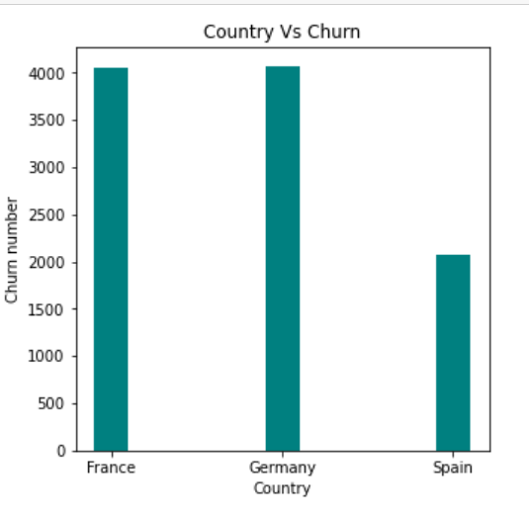
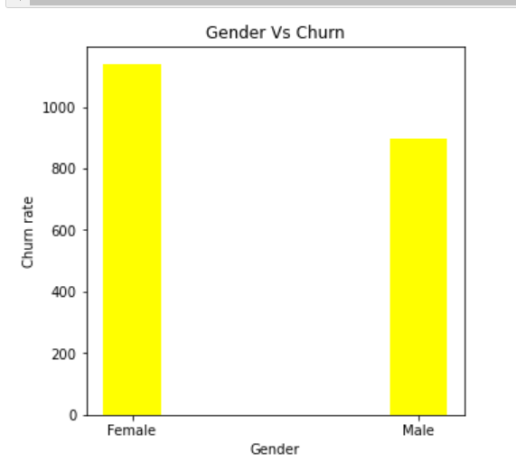
Data Visualization(Exploratory Data Analysis)

Slide 10
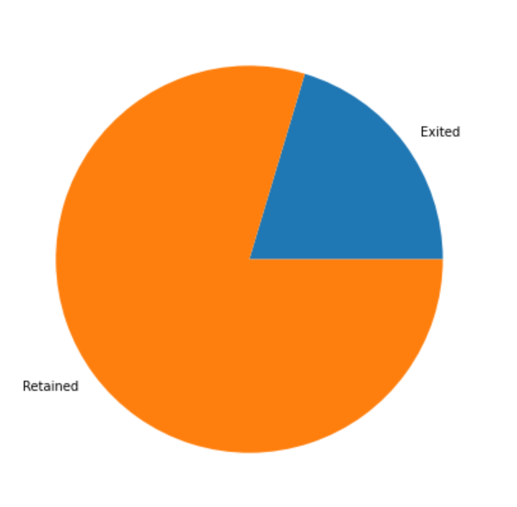
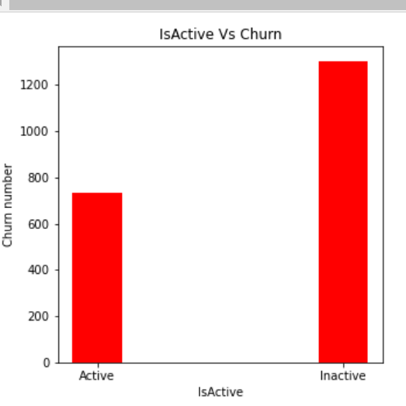

Slide 11
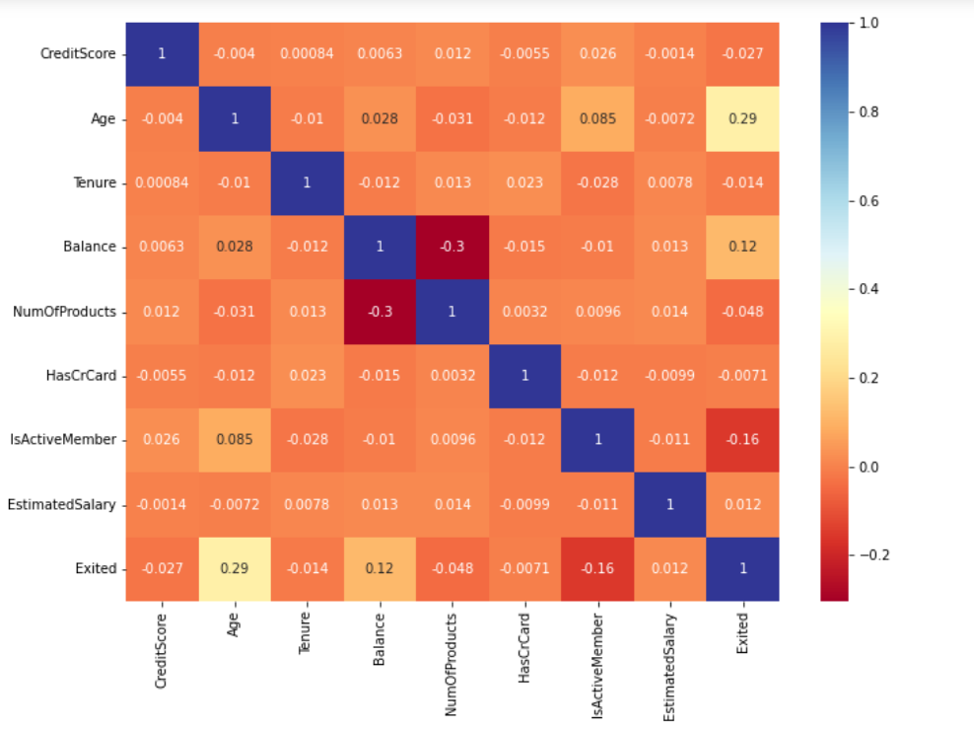

Slide 12
Building Predictive Models
We used these algorithms to build our predictive models
Logistic regression is the appropriate regression analysis to conduct when the dependent variable is dichotomous (binary). Logistic regression is used to describe data and to explain the relationship between one dependent binary variable and one or more nominal, ordinal, interval or ratio-level independent variables.
A random forest is a machine learning technique that’s used to solve regression and classification problems. It utilizes ensemble learning, which is a technique that combines many classifiers to provide solutions to complex problems.

Slide 13
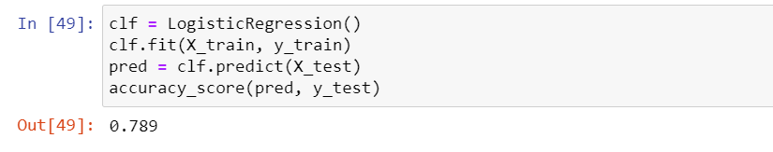
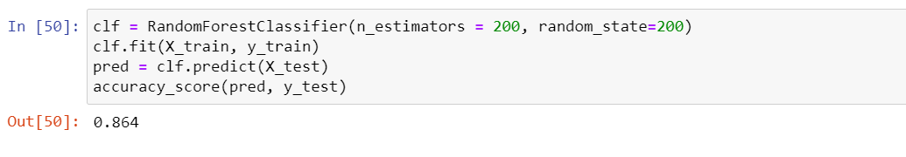
Analysis and Model Accuracy
Logistic Regression
Random Forest

Slide 14
Conclusion
Random forest gives more accuracy than Logistic regression since data mostly comprised of categorical variables and depicts more non-linearity.
With these models, Banks can have an idea of what factors affect customers leave or attract , and through this analysis , they can improve their services and introduce new schemes to attract more customers .

Slide 15

THANK YOU

